Slide 1

BANDIT PROBLEMS
By: Dimple Bohra

Slide 2
Formal Definition of RL
. . .
r
t +1
r
t +2
r
. . .
s
s
t +1
s
t +2
t +3
s
t +3
t
a
a
t +1
a
t +2
a
t
t +3
Notes:
In this chapter we study the evaluative aspect of reinforcement learning in a simplified setting, one that does not involve learning to act in more than one situation. This nonassociative setting is the one in which most prior work involving evaluative feedback has been done, and it avoids much of the complexity of the full reinforcement learning problem. Studying this case will enable us to see most clearly how evaluative feedback differs from, and yet can be combined with, instructive feedback.

Slide 3
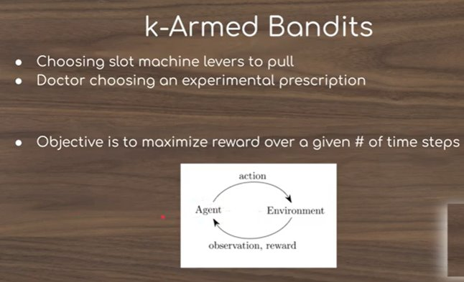
k-armed Bandit problem
Notes:
In this chapter we study the evaluative aspect of reinforcement learning in a simplified setting, one that does not involve learning to act in more than one situation. This nonassociative setting is the one in which most prior work involving evaluative feedback has been done, and it avoids much of the complexity of the full reinforcement learning problem. Studying this case will enable us to see most clearly how evaluative feedback differs from, and yet can be combined with, instructive feedback.

Slide 4
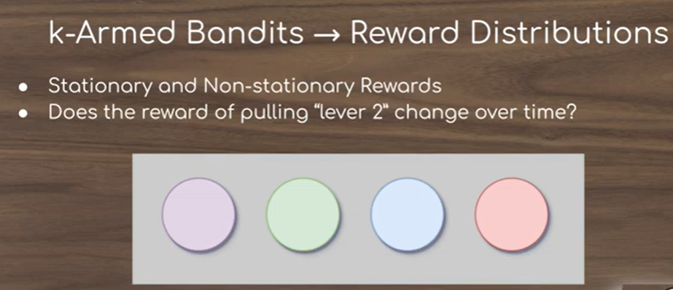
k-armed Bandit problem
Notes:
In this chapter we study the evaluative aspect of reinforcement learning in a simplified setting, one that does not involve learning to act in more than one situation. This nonassociative setting is the one in which most prior work involving evaluative feedback has been done, and it avoids much of the complexity of the full reinforcement learning problem. Studying this case will enable us to see most clearly how evaluative feedback differs from, and yet can be combined with, instructive feedback.

Slide 5
The k-Armed Bandit Problem
Here, You are faced repeatedly with a choice among k different options, or actions. After each choice you receive a numerical reward chosen from a stationary probability distribution that depends on the action you selected. Your objective is to maximize the expected total reward over some time period, for example, over 1000 action selections, or time steps.
This is the original form of the k-armed bandit problem, so named by analogy to a slot machine, or “one-armed bandit,” except that it has k levers instead of one. Each action selection is like a play of one of the slot machine’s levers, and the rewards are the payoffs for hitting the jackpot
Notes:
The particular nonassociative, evaluative feedback problem that we explore is a simple version of the n-armed bandit problem. We use this problem to introduce a number of basic learning methods which we extend in later chapters to apply to the full reinforcement learning problem.

Slide 6
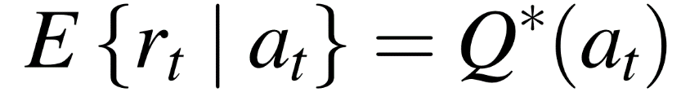
The k-Armed Bandit Problem
Choose repeatedly from one of k actions; each choice is called a play
After each play , you get a reward , where
These are unknown action values
Distribution of depends only on
Objective is to maximize the reward in the long term, e.g., over 1000 plays
To solve the k-armed bandit problem,
you must explore a variety of actions
and exploit the best of them

Slide 7
The Exploration/Exploitation Dilemma
Suppose you form estimates
The greedy action at t is a_{t}
You can’t exploit all the time; you can’t explore all the time
You can never stop exploring; but you should always reduce exploring.
action value estimates

Slide 8

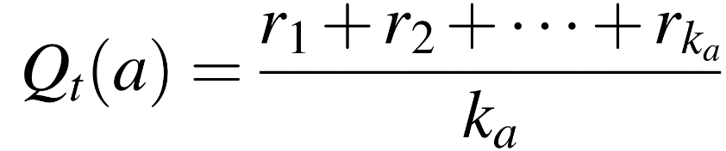
Action-Value Methods
Methods that adapt action-value estimates and nothing else, e.g.: suppose by the t-th play, action had been chosen times, producing rewards then
OR
“sample average”

Slide 9

Sample Average Method
If = 0, then we define Qt(a) instead as some default value, such as Q1(a) = 0.
As → ∞, by the law of large numbers, Qt(a) converges to q*(a).
We call this the sample-average method for estimating action values because each estimate is a simple average of the sample of relevant rewards.

Slide 10
Greedy Action Selection
The simplest action selection rule is to select the action (or one of the actions) with highest estimated action value, that is, to select at step t one of the greedy actions.
This greedy action selection method can be written as
where denotes the value of a, at which the expression that follows is maximized
Notes:
Greedy action selection always exploits current knowledge to maximize immediate reward; it spends no time at all sampling apparently inferior actions to see if they might really be better.

Slide 11
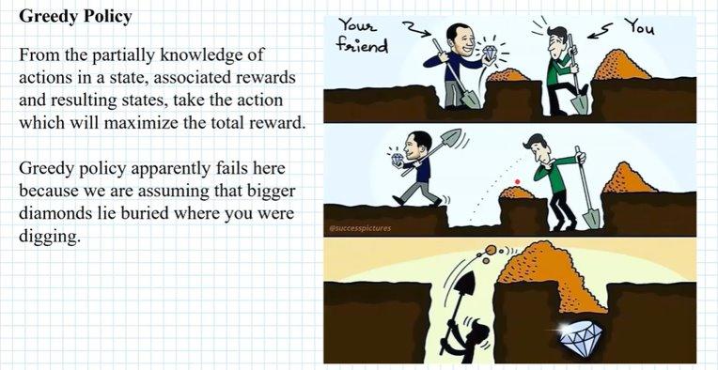
Greedy Policy

Slide 12
ε-Greedy Action Selection
A simple alternative is to behave greedily most of the time, but every once in a while, say with small probability ε, instead to select randomly from amongst all the actions with equal probability independently of the action value estimates.
We call methods using this near-greedy action selection rule ε-greedy methods
Notes:
Greedy action selection always exploits current knowledge to maximize immediate reward; it spends no time at all sampling apparently inferior actions to see if they might really be better.

Slide 13
ε-Greedy Action Selection
Greedy action selection:
ε-Greedy:
{
. . . the simplest way to balance exploration and exploitation

Slide 14
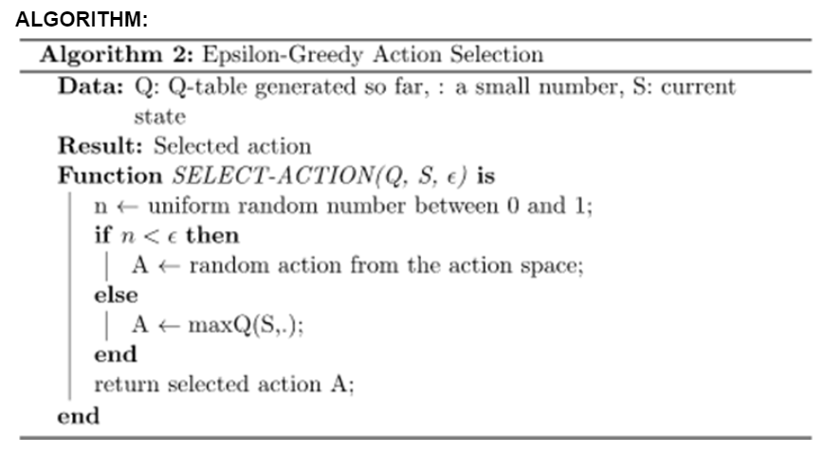
Epsilon-Greedy Action Selection Algorithm

Slide 15
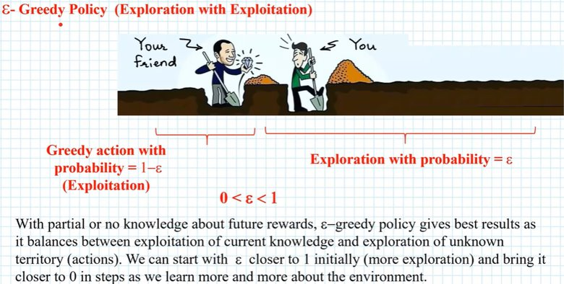
ε-Greedy Action Selection

Slide 16
Greedy Vs ε-Greedy Methods
The advantage of ε-greedy over greedy methods depends on the task. For example, suppose the reward variance had been larger, say 10. With noisier rewards, it takes more exploration to find the optimal action, and ε-greedy methods should fare even better relative to the greedy method.
On the other hand, if the reward variances were zero, then the greedy method would know the true value of each action after trying it once. In this case, the greedy method might actually perform best because it would soon find the optimal action and then never explore.
Notes:
But even in the deterministic case, there is a large advantage to exploring if we weaken some of the other assumptions. For example, suppose the bandit task were nonstationary, that is, that the true values of the actions changed over time. In this case exploration is needed even in the deterministic case to make sure one of the nongreedy actions has not changed to become better than the greedy one. As we will see in the next few chapters, effective nonstationarity is the case most commonly encountered in reinforcement learning. Even if the underlying task is stationary and deterministic, the learner faces a set of banditlike decision tasks each of which changes over time due to the learning process itself. Reinforcement learning requires a balance between exploration and exploitation

Slide 17
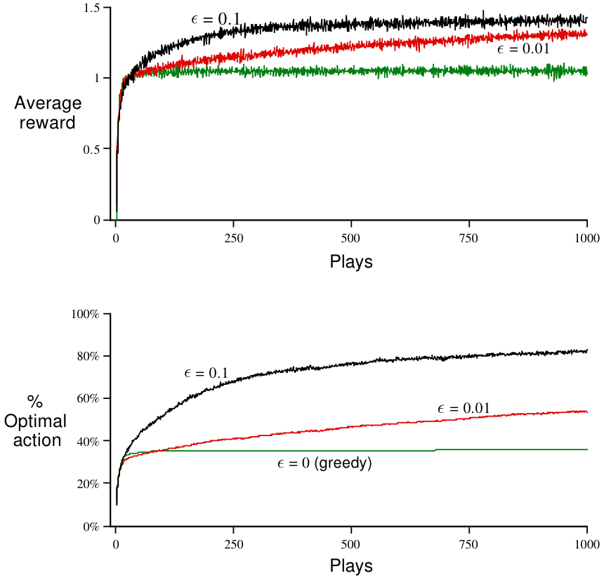
Greedy Vs ε-Greedy Methods
Notes:
The upper graph shows the increase in expected reward with experience. The greedy method improved slightly faster than the other methods at the very beginning, but then leveled off at a lower level. It achieved a reward per step of only about 1, compared with the best possible of about 1.55 on this testbed. The greedy method performs significantly worse in the long run because it often gets stuck performing suboptimal actions. The lower graph shows that the greedy method found the optimal action in only approximately one-third of the tasks. In the other two-thirds, its initial samples of the optimal action were disappointing, and it never returned to it. The ε-greedy methods eventually perform better because they continue to explore, and to improve their chances of recognizing the optimal action
0.1 find optimal action faster but never use it more than 91%
0.01 finds optimal action slowly but eventually performs better
So we can reduce epsilon value to get best of both high and low values

Slide 18
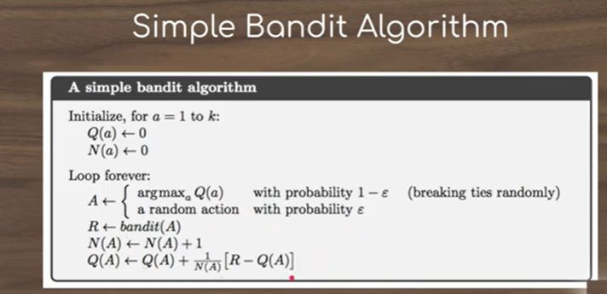
Simple Bandit Algorithm

Slide 19
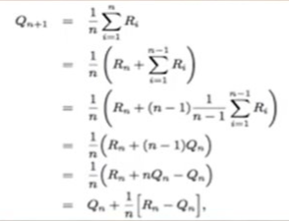
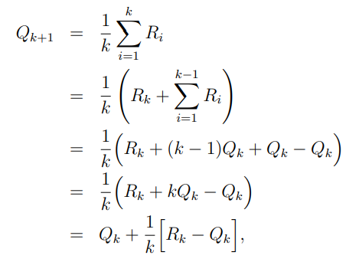
Incremental Implementation
The average of the first k rewards is
Can we do this incrementally (without storing all the rewards)?
This is a common form for update rules:
NewEstimate = OldEstimate + StepSize[Target – OldEstimate]
Notes:
A problem with this straightforward implementation is that its memory and computational requirements grow over time without bound. That is, each additional reward following a selection of action a requires more memory to store it and results in more computation being required to determine Qt(a).
As you might suspect, this is not really necessary. It is easy to devise incremental update formulas for computing averages with small, constant computation required to process each new reward. For some action, let Qk denote the estimate for its kth reward, that is, the average of its first k − 1 rewards. Given this average and a kth reward for the action, Rk, then the average of all k rewards can be computed by

Slide 20
Incremental Implementation
The expression [Target − OldEstimate] is an error in the estimate.
It is reduced by taking a step toward the “Target.” The target is presumed to indicate a desirable direction in which to move, though it may be noisy.
In the case above, for example, the target is the kth reward. Note that the step-size parameter (StepSize) used in the incremental method described above changes from time step to time step.
In processing the kth reward for an action a, that method uses a step-size parameter of 1/k .
Step size parameter is denoted by α or αt(a).

Slide 21
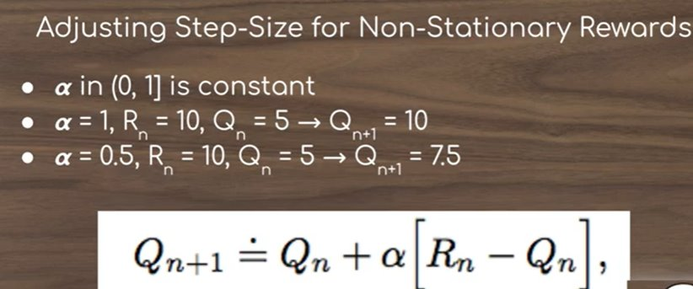
Tracking a Nonstationary Problem

Slide 22

Tracking a Nonstationary Problem
In case of Nonstationary, it makes sense to weight recent rewards more heavily than long-past ones.
One of the most popular ways of doing this is to use a constant step-size parameter.
For example, the incremental update rule for updating an average Qk of the k − 1 past rewards is modified to be :
where the step-size parameter α ∈ (0, 1] is constant. This results in Qk+1 being a weighted average of past rewards and the initial estimate Q1
Notes:
The averaging methods discussed so far are appropriate in a stationary environment, but not if the bandit is changing over time. As noted earlier, we often encounter reinforcement learning problems that are effectively nonstationary
The notation (a, b] as a set denotes the real interval between a and b including b but not including a. Thus, here we are saying that 0 < α ≤ 1.

Slide 23
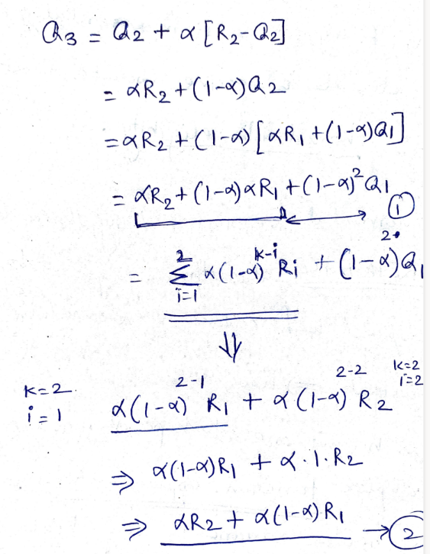
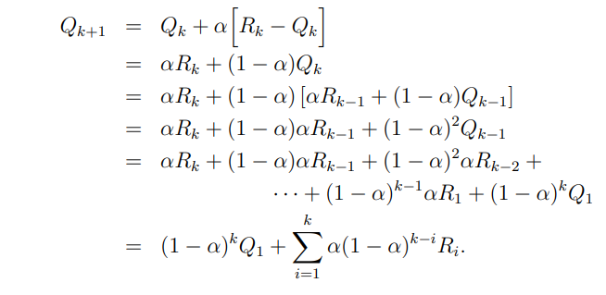
Tracking a Nonstationary Problem
sometimes called an exponential, recency-weighted average
Notes:
We call this a weighted average because the sum of the weights is (1 − α) P k + k i=1 α(1 − α) k−i = 1, as you can check yourself. Note that the weight, α(1 − α) k−i , given to the reward Ri depends on how many rewards ago, k − i, it was observed. The quantity 1 − α is less than 1, and thus the weight given to Ri decreases as the number of intervening rewards increases. In fact, the weight decays exponentially according to the exponent on 1 − α. (If 1 − α = 0, then all the weight goes on the very last reward, Rk, because of the convention that 0 0 = 1.)

Slide 24
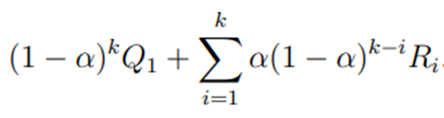
Tracking a Nonstationary Problem
Qk+1 =
E.g.
α=0.8,
so,
Q3= (1-0.8)² + (0.8 (1-0.8)²⁻¹ + 0.8 (1-0.8)²⁻² )
= (0.2)² + (0.16 + 0.8)
= 0.04 + 0.96
= 1

Slide 25
Tracking a Nonstationary Problem
Sometimes it is convenient to vary the step-size parameter from step to step. Let αk(a) denote the step-size parameter used to process the reward received after the kth selection of action a.
The choice αk(a) = 1/k results in the sample-average method, which is guaranteed to converge to the true action values by the law of large numbers.
But of course, convergence is not guaranteed for all choices of the sequence {αk(a)}.

Slide 26
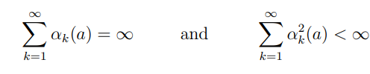
Tracking a Nonstationary Problem
A well known result in stochastic approximation theory gives us the conditions required to assure convergence with probability 1:
The first condition is required to guarantee that the steps are large enough to eventually overcome any initial conditions or random fluctuations.
The second condition guarantees that eventually the steps become small enough to assure convergence.
Notes:
Note that both convergence conditions are met for the sample-average case, αk(a) = 1 k , but not for the case of constant step-size parameter, αk(a) = α. In the latter case, the second condition is not met, indicating that the estimates never completely converge but continue to vary in response to the most recently received rewards. As we mentioned above, this is actually desirable in a nonstationary environment, and problems that are effectively nonstationary are the norm in reinforcement learning. In addition, sequences of step-size parameters that meet the conditions (2.7) often converge very slowly or need considerable tuning in order to obtain a satisfactory convergence rate. Although sequences of step-size parameters that meet these convergence conditions are often used in theoretical work, they are seldom used in applications and empirical research.

Slide 27
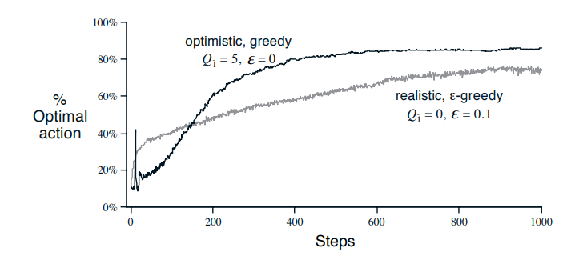
Optimistic Initial Values
All the methods we have discussed so far are dependent to some extent on the initial action-value estimates, Q1(a).
In the language of statistics, these methods are biased by their initial estimates.
For the sample-average methods, the bias disappears once all actions have been selected at least once, but for methods with constant α, the bias is permanent, though decreasing over time (Qk+1)as given by equation in previous slide.
In practice, this kind of bias is usually not a problem, and can sometimes be very helpful.
Figure : The effect of optimistic initial action-value estimates on the 10- armed testbed. Both methods used a constant step-size parameter, α = 0.1.
Notes:
This method is like a little hack that encourages the agent to explore in the beginning.
The value of Q0 can be set to some high positive value- for example, 30. Now, since the maximum reward is only 10, our value Q0 is wildly optimistic. Whichever action the agent chooses, it’ll receive a reward that is less that the value estimates and so, it’ll then explore the other actions.
Please note that the effect of this hack is only temporary and can mostly be noticed at the beginning.
Figure 2.2 shows the performance on the 10-armed bandit testbed of a
greedy method using Q1(a) = +5, for all a. For comparison, also shown is an
ε-greedy method with Q1(a) = 0. Initially, the optimistic method performs
worse because it explores more, but eventually it performs better because its
exploration decreases with time.

Slide 28
Optimistic Initial Values
The downside is that the initial estimates become, in effect, a set of parameters that must be picked by the user, if only to set them all to zero.
The upside is that they provide an easy way to supply some prior knowledge about what level of rewards can be expected.
Initial action values can also be used as a simple way of encouraging exploration

Slide 29
Optimistic Initial Values
Figure shows the performance on the 10-armed bandit testbed of a greedy method using Q1(a) = +5, for all a.
For comparison, also shown is an ε-greedy method with Q1(a) = 0. Initially, the optimistic method performs worse because it explores more, but eventually it performs better because its exploration decreases with time.
We call this technique for encouraging exploration optimistic initial values

Slide 30
How Optimistic Initial Values works?
This method is like a little hack that encourages the agent to explore in the beginning.
We start by assuming all actions are optimum. We do this by assigning all actions an initial value larger than the mean reward we expect to receive after pulling any arm.
As a result of this, the first estimate of any action will always be less than this optimum initial value. And, even if we’re greedy, we’ll not visit this action again and rather select another unvisited action.
This approach encourages the agent to visit all actions multiple times, resulting in early improvement in estimated action values.

Slide 31

Upper-Confidence-Bound Action Selection
Considering the working of Greedy and ε-Greedy algorithm, it would be better to select among the non-greedy actions according to their potential for actually being optimal, taking into account both how close their estimates are to being maximal and the uncertainties in those estimates.
One effective way of doing this is to select actions as
Notes:
Rather than performing exploration by simply selecting an arbitrary action, chosen with a probability that remains constant, the UCB algorithm changes its exploration-exploitation balance as it gathers more knowledge of the environment. It moves from being primarily focused on exploration, when actions that have been tried the least are preferred, to instead concentrate on exploitation, selecting the action with the highest estimated reward.
With UCB, ‘Aₜ’, the action chosen at time step ‘t’, is given by:
where lnt denotes the natural logarithm of t (the number that e ≈ 2.71828 would have to be raised to in order to equal t), and the number c > 0 controls the degree of exploration. If Nt(a) = 0, then a is considered to be a maximizing action.

Slide 32
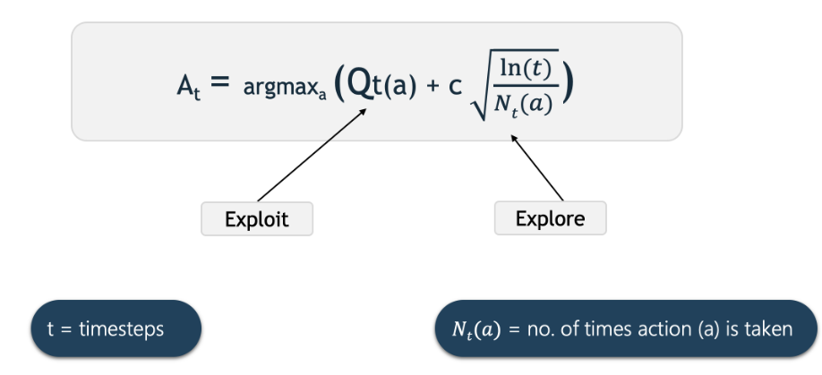
UCB Action Selection
Qₜ(a) is the estimated value of action ‘a’ at time step ‘t’.
Nₜ(a) is the number of times that action ‘a’ has been selected, prior to time ‘t’.
‘c’ is a confidence value that controls the level of exploration.
Notes:
The second half of the equation adds exploration, with the degree of exploration being controlled by the hyper-parameter ‘c’. Effectively this part of the equation provides a measure of the uncertainty for the action’s reward estimate.
If an action hasn’t been tried very often, or not at all, then Nₜ(a) will be small. Consequently the uncertainty term will be large, making this action more likely to be selected. Every time an action is taken we become more confident about its estimate. In this case Nₜ(a) increments, and so the uncertainty term decreases, making it less likely that this action will be selected as a result of exploration (although it may still be selected as the action with the highest value, due to the exploitation term).
When an action is not being selected, the uncertainty term will grow slowly, due to the log function in the numerator. Whereas, every time that the action is selected, the uncertainty will shrink rapidly due to the increase in Nₜ(a) being linear. So the exploration term will be larger for actions that have been selected infrequently, due to the uncertainty in the estimates of their rewards.
As time progresses the exploration term gradually decreases (since as ’n’ goes to infinity log n/n goes to zero), until eventually actions are selected based only on the exploitation term.

Slide 33
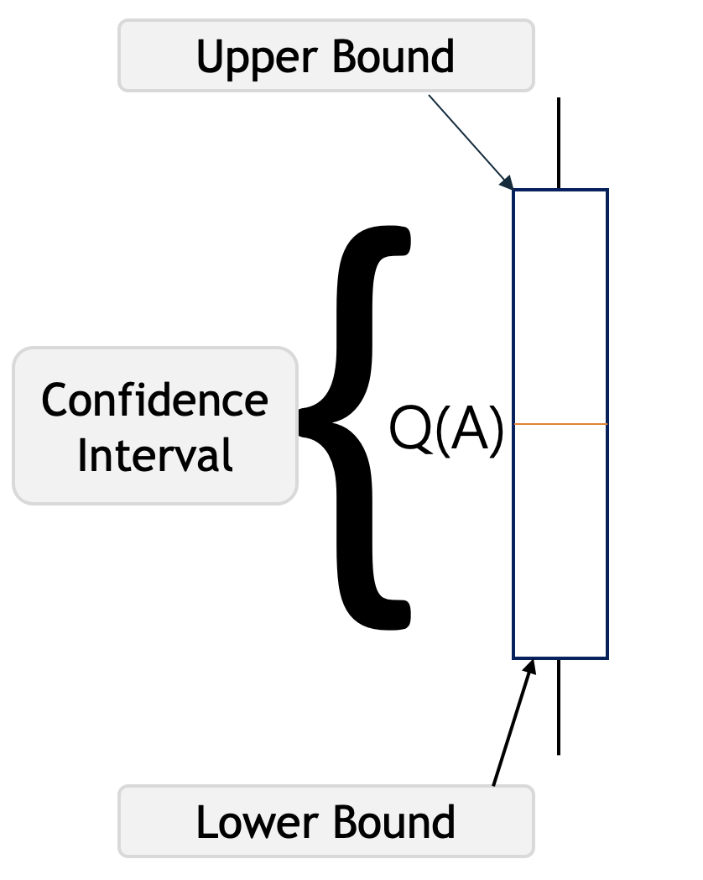
UCB Action Selection
The Upper Confidence Bound follows the principle of optimism in the face of uncertainty which implies that if we are uncertain about an action, we should optimistically assume that it is the correct action.
Notes:
Q(A) in the above picture represents the current action-value estimate for action A. The brackets represent a confidence interval around Q*(A) which says that we are confident that the actual action-value of action A lies somewhere in this region.
The lower bracket is called the lower bound, and the upper bracket is the upper bound. The region between the brackets is the confidence interval which represents the uncertainty in the estimates. If the region is very small, then we become very certain that the actual value of action A is near our estimated value. On the other hand, if the region is large, then we become uncertain that the value of action A is near our estimated value.

Slide 34
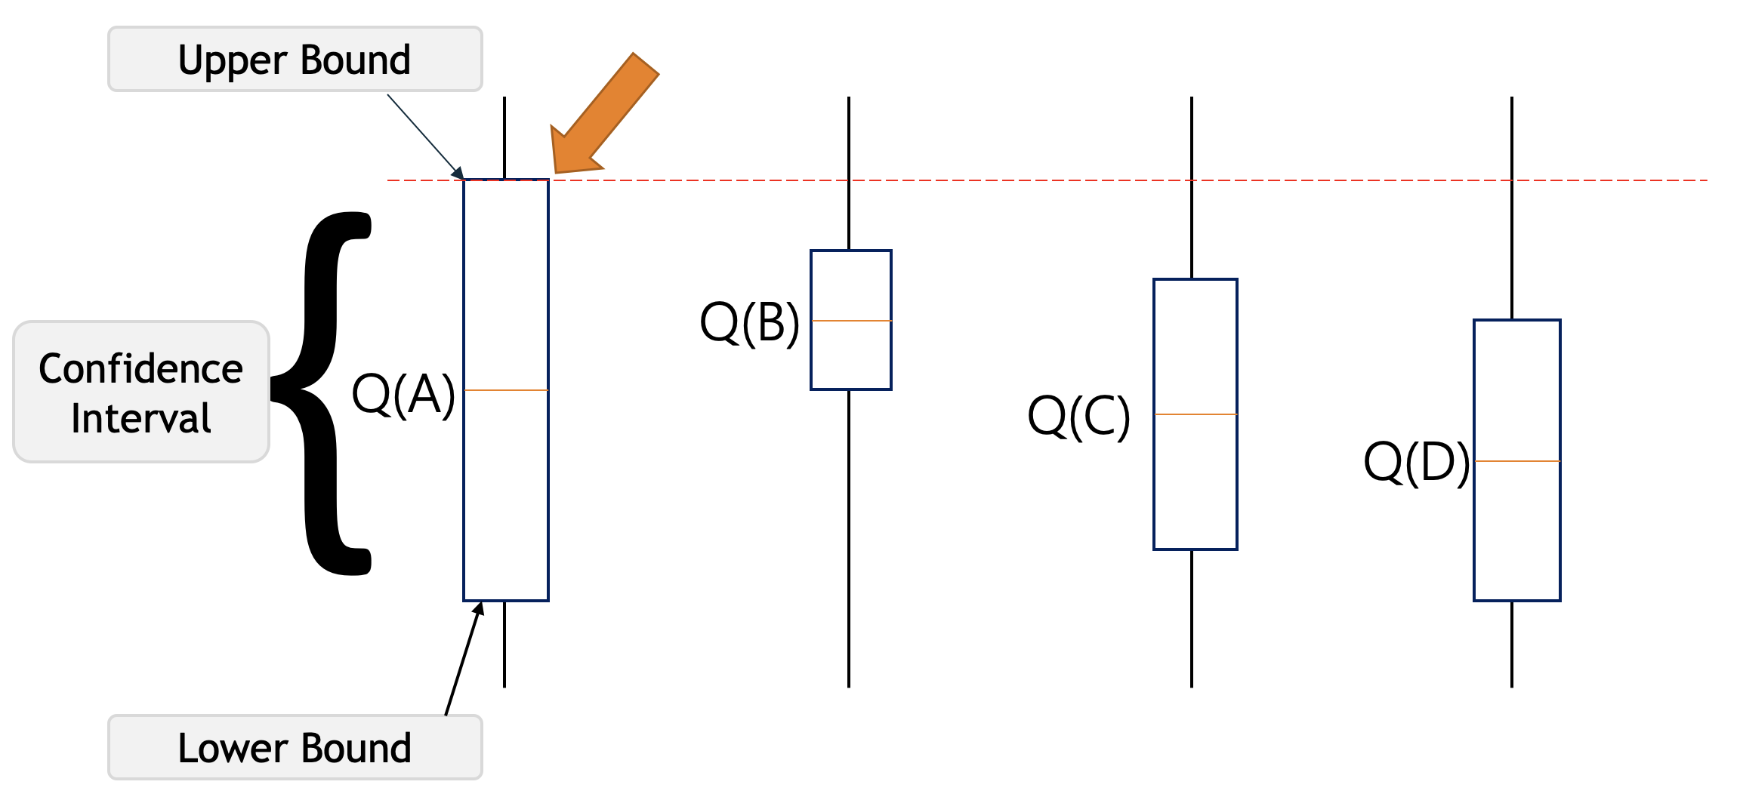
UCB Action Selection
Notes:
For example, let’s say we have these four actions with associated uncertainties in the picture below, our agent has no idea which is the best action. So according to the UCB algorithm, it will optimistically pick the action that has the highest upper bound i.e. A. By doing this either it will have the highest value and get the highest reward, or by taking that we will get to learn about an action we know least about.

Slide 35
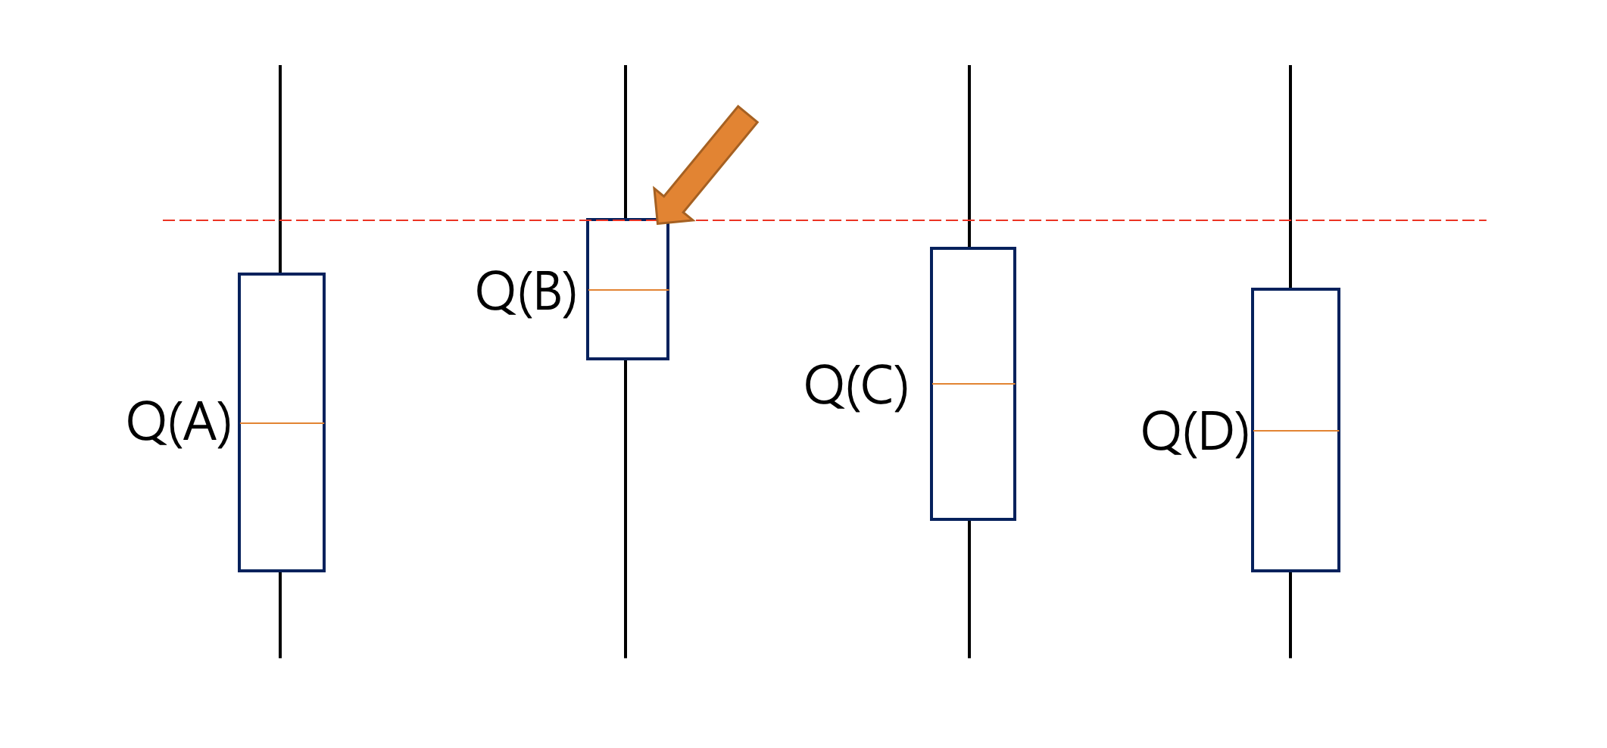
UCB Action Selection
Notes:
Let’s assume that after selecting the action A we end up in a state depicted in the picture below. This time UCB will select the action B since Q(B) has the highest upper-confidence bound because it’s action-value estimate is the highest, even though the confidence interval is small.
Initially, UCB explores more to systematically reduce uncertainty but its exploration reduces over time. Thus we can say that UCB obtains greater reward on average than other algorithms such as Epsilon-greedy, Optimistic Initial Values, etc.

Slide 36
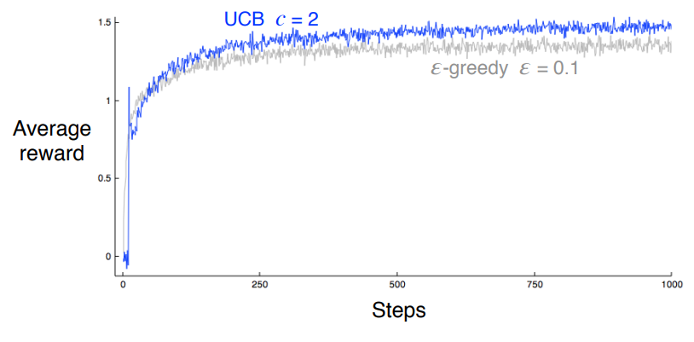
UCB Action Selection
As shown, UCB generally performs better than ε-greedy action selection, except in the first n plays, when it selects randomly among the as-yet unplayed actions.
UCB with c = 1 would perform even better but would not show the prominent spike in performance on the 11th play.
Figure: Average performance of UCB action selection on the 10-armed testbed.

Slide 37
UCB Action Selection
UCB will often perform well, but is more difficult than ε-greedy to extend beyond bandits to the more general reinforcement learning.
One difficulty is in dealing with nonstationary problems; something more complex than the methods discussed so far would be needed.
Another difficulty is dealing with large state spaces

Slide 38
Thompson Sampling (Posterior Sampling or Probability Matching) Algorithm
All the methods we’ve seen for tackling the Bandit Problem have selected their actions based on the current averages of the rewards received from those actions.
Thompson Sampling (also sometimes referred to as the Bayesian Bandits algorithm) takes a slightly different approach; rather than just refining an estimate of the mean reward it extends this, to instead build up a probability model from the obtained rewards, and then samples from this to choose an action.
Notes:
In this way, not only is an increasingly accurate estimate of the possible reward obtained, but the model also provides a level of confidence in this reward, and this confidence increases as more samples are collected. This process of updating your beliefs as more evidence becomes available is known as Bayesian Inference.

Slide 39
Bernoulli Thompson Sampling
As an introduction, and to make things easier to work with, let’s simplify the available rewards i.e., 1 or 0.
When a random variable has only two possible outcomes its behavior can be described by the Bernoulli distribution.
Bernoulli distribution is a discrete probability distribution where the Bernoulli random variable can have only 0 or 1 as the outcome. p is the probability of success and 1 - p is the probability of failure.
Notes:
let’s simplify the power socket problem. Now, instead of each socket returning a varying amount of charge, each socket will either return some charge or no charge; the rewards have only two possible values: 1 when the chosen socket supplies a charge and 0 when it doesn’t.
So now, instead of the amount of charge varying per socket, the probability of a socket producing a charge varies with each socket. We want to find the socket with the highest probability of returning a charge, rather than the socket that gives the most charge.
As already mentioned, Thompson Sampling generates a model of the reward probabilities. When, as in this case, the available rewards are binary (win or lose, yes or no, charge or no charge) then the Beta distribution is ideal to model this type of probability.

Slide 40

Thompson Sampling
Thompson Sampling generates a model of the reward probabilities. When, as in this case, the available rewards are binary (win or lose, yes or no) then the Beta distribution is ideal to model this type of probability.
The Beta distribution takes two parameters, ‘α’ (alpha) and ‘β’ (beta). In the simplest terms these parameters can be thought of as respectively the count of successes and failures.
Additionally, a Beta distribution has a mean value given by:
Notes:
In probability theory and statistics, the beta distribution is a family of continuous probability distributions defined on the interval [0, 1] in terms of two positive parameters, denoted by alpha (α) and beta (β), that appear as exponents of the variable and its complement to 1, respectively, and control the shape of the distribution.
The beta distribution has been applied to model the behavior of random variables limited to intervals of finite length in a wide variety of disciplines. The beta distribution is a suitable model for the random behavior of percentages and proportions.
In Bayesian inference, the beta distribution is the conjugate prior probability distribution for the Bernoulli, binomial, negative binomial and geometric distributions.

Slide 41
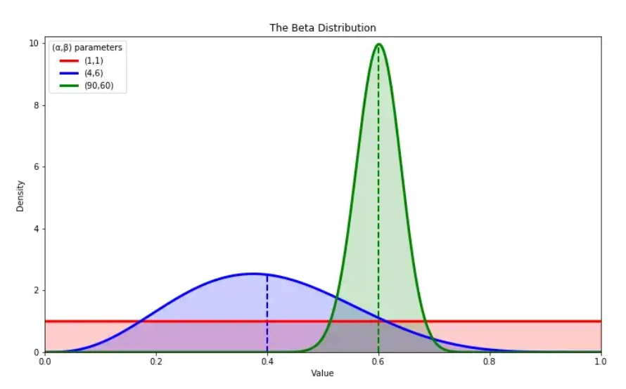
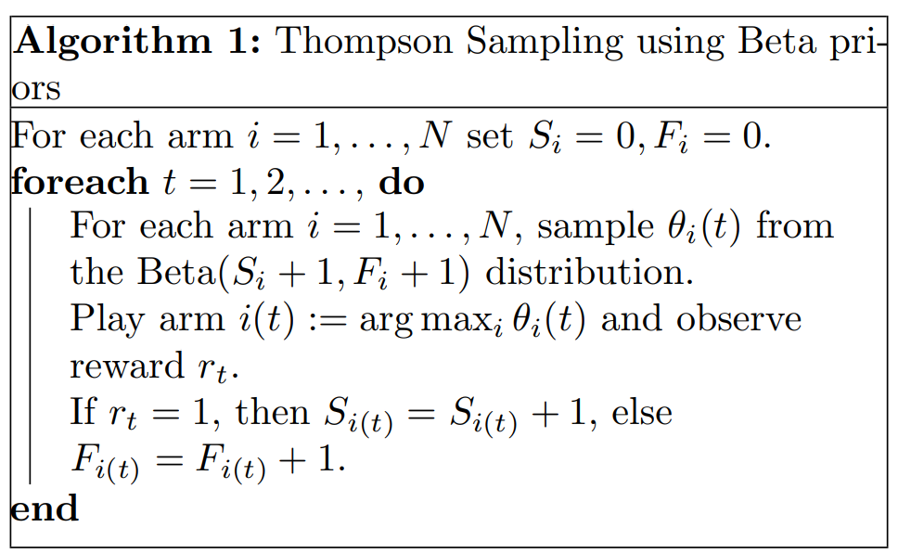
Thompson Sampling
Figure: The Beta distribution for various values of alpha and beta.
Prior: Beta(α,β)
Posterior: If reward: Beta(α+1,β)
Else : Beta(α,β+1)
Notes:
This initial guess at the probability of the socket producing an output is known as the Prior Probability; it is the probability of the specific event occurring before we have collected any evidence and in this case is represented by the Beta distribution Beta(1,1).
Once we test a socket, and obtain a reward, we can modify our belief in the likelihood of that socket returning some charge. This new probability, after some evidence has been collected, is known as the Posterior Probability. Again this is given by a Beta distribution, but now the values of ‘α’ and ‘β’ are updated with the value of the returned reward.
So, if a socket returns some charge, the reward will be 1 and ‘α’, the count of the number of successes, will increment by 1. The count of the number of failures, ‘β’, will not increase. If instead no reward was obtained, then ‘α’ will stay the same and ‘β’ will increment by 1. As more data is collected the Beta distribution moves from being a flat line to become an increasingly accurate model of the probability of the mean reward. By maintaining the values of ‘α’ and ‘β’ a Thompson sampling algorithm is able to describe the estimated mean reward and the level of confidence in this estimate.
In contrast to the Greedy algorithm, which at each time step selects the action with the highest estimated reward, even if the confidence in that estimate is low, Thompson sampling instead samples from the Beta distribution of each action and chooses the action with the highest returned value. Since actions that have been tried infrequently have wide distributions (see the blue curve in figure 5.1), they have a larger range of possible values. In this way, a socket that is currently has a low estimated mean reward, but has been tested fewer times than a socket with a higher estimated mean, can return a larger sample value and therefore become the selected socket at this time step.
In the graph above, the blue curve has a lower estimated mean reward than the green curve. Therefore, under Greedy selection, green would be chosen and the blue socket would never be selected. In contrast, Thompson Sampling effectively considers the full width of the curve, which for the blue socket can be seen to extend beyond that of the green socket. In this case the blue socket may be selected in preference to the green one.
As the number of trials of a socket increases the confidence in the estimated mean increases. This is reflected in the probability distribution becoming narrower and the sampled value will then be drawn from a range of values that are closer to the true mean (see the green curve in figure 5.1). As a result, exploration decreases and exploitation increases, since the sockets with a higher probability of returning a reward will begin to be selected with increasing frequency.
On the other hand, sockets with a low estimated mean will start to be selected less frequently and will tend to be dropped early from the selection process. Consequently, their true mean may never be found. Since we are only interested in finding the socket with the highest probability of returning a reward, and finding it as quickly as possible, we don’t care if full information of poorly performing sockets is never obtained.
Suppose a robot has to pick several cans and put them in a container. Each time it puts the can to the container, it will memorize the steps followed and train itself to perform the task with better speed and precision (reward). If the Robot is not able to put the can in the container, it will not memorize that procedure (hence speed and performance will not improve) and will be considered as a penalty.
Thompson Sampling has the advantage of the tendency to decrease the search as we get more and more information, which mimics the desirable trade-off in the problem, where we want as much information as possible in fewer searches. Hence, this Algorithm has a tendency to be more “search-oriented” when we have fewer data and less “search-oriented” when we have a lot of data.

Slide 42
Policy Gradient Approaches
The goal of any Reinforcement Learning(RL) algorithm is to determine the optimal policy that has a maximum reward.
Policy gradient algorithm is a policy iteration approach where policy is directly manipulated to reach the optimal policy that maximizes the expected return.
This type of algorithms is model-free reinforcement learning(RL).
Notes:
The model-free indicates that there is no prior knowledge of the model of the environment. In other words, we do not know the environment dynamics or transition probability.

